Slide 1
Protective Landing Device
experiments

Slide 2
Purpose: Create packaging around an uncooked egg to ensure that the egg can be dropped from a height without breaking. Lab Activity Instructions:
Design and construct an egg protective device in groups.
Limited materials to choose from.
Test devices in the classroom first and then later at the drop site.

Slide 3
Criteria or constraint?
➢ No parachutes are allowed
➢ An area approximately the size of a quarter of the egg must be easily visible at all times.
➢ Only the allowed materials may be used. Items can be negotiated and traded with other designers.
➢ Only raw, store bought chicken eggs may be used.
➢ Your design must not include changing the egg in any way (no tape on the egg, no soaking the egg in vinegar).
➢ The egg container and all materials must remain intact. For example, no parts – inside or out - can fall or break off during flight or impact.
➢ Your egg project must fit on a regular size (8 ½ x 11) sheet of paper. (Note that the height of the container is not a factor – it can be “tall” and still fit on the paper)
➢ The container must be able to be opened once we return to the classroom so that we may check on the condition of the egg. The inside materials must be designed to allow raw egg to be easily inserted and removed.
➢ Must withstand numerous drops
➢ Work in teams

Slide 4
Materials: You can choose 12 items/materials from the following list:
5 elastic bands,
8 popsicle sticks,
1 meter of tape,
2 sheets of paper,
1 plastic bag,
4 straws,
1 Styrofoam cup,
1 manila folder,
6 cotton balls,
8 Q-tips,
10’ toilet paper,
30cm string,
10cm wires,
20 pieces spaghetti,
2 skinny balloons,
1 paper plate,
1 piece newspaper
These materials are provided: • glue, scissors, rulers, pencil

Slide 5
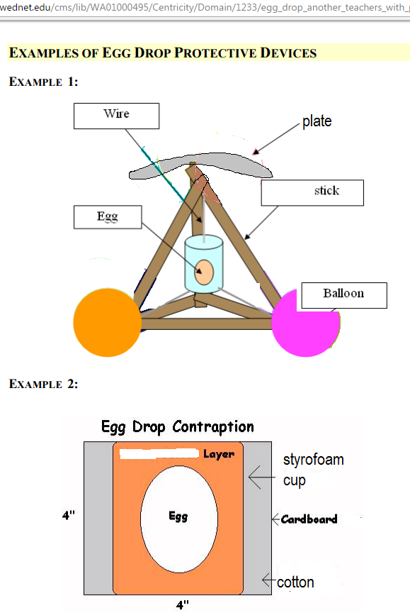
examples
Draw at least 2 different designs

Slide 6
Test secondary impact with a dummy
Scientists and engineers have been working for many years to reduce the effect of impacts, primarily in the automobile industry.
Efforts to reduce the primary impact (energy absorbing bumpers, crumple zones, modified chassis construction) and efforts to reduce the secondary impact (airbags, padded dashboards, collapsing steering wheels, and seatbelts) are commonplace.

Slide 7
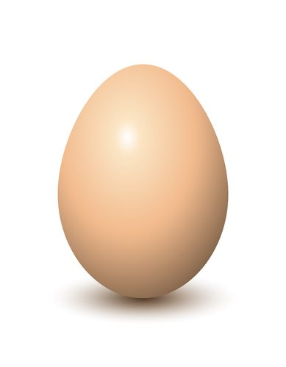
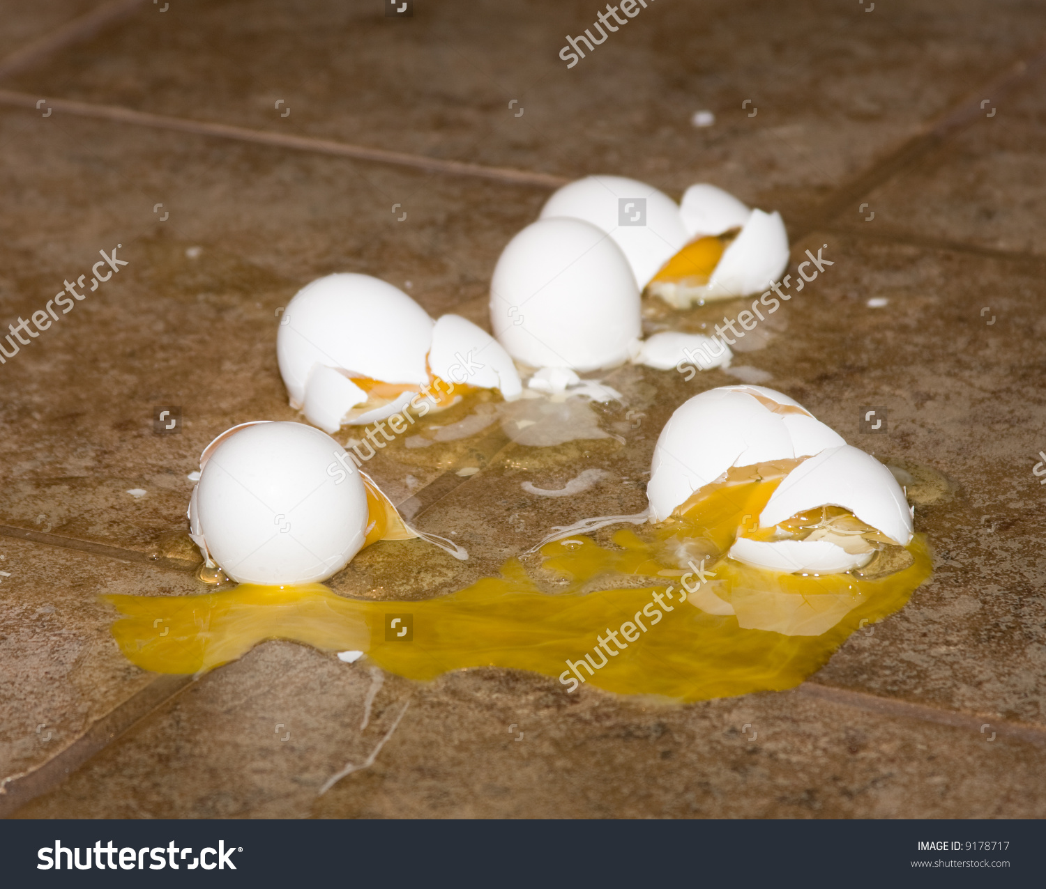
Design your crash dummy
Same size and weight

Slide 8
Procedure: Phase 1:
The Design
When you are designing this apparatus, there are a few things that you need to keep in mind.
This device must be protective.
The raw egg inside must not even crack at the first drop.

Slide 9
Phase Two: Testing
After classroom testing, do practice runs at the drop site to make sure that your apparatus will withstand these tests.
The project takes much trial and error and it is highly doubtful that you will succeed in your design on the first trial.
Plan to modify your current design or start completely over and design a new apparatus.
Raw eggs are provided at the drop site.
Bring a small repair kit for your apparatus, i.e. tape, scissors, and left-over materials provided etc. Be fully prepared and bring all items to the drop site.
Phase Three: Actual Drop

Slide 10
Hints:
A regular egg is 2.5 – 3 grams in weight
It’s the same as about 10-11 marbles
• Use light and strong materials
• Use simplified apparatuses
• Bring a repair kit to the drop site
• Don't overcomplicate the design
• Don't use heavy materials if at all possible
Test effectively
Start with low heights
Increase height gradually
repeat and observe from above and below

